Slide 1
Lesson #1
Integrated Development Environment
Variables and Data Types
Libraries
Algorithm

Slide 2
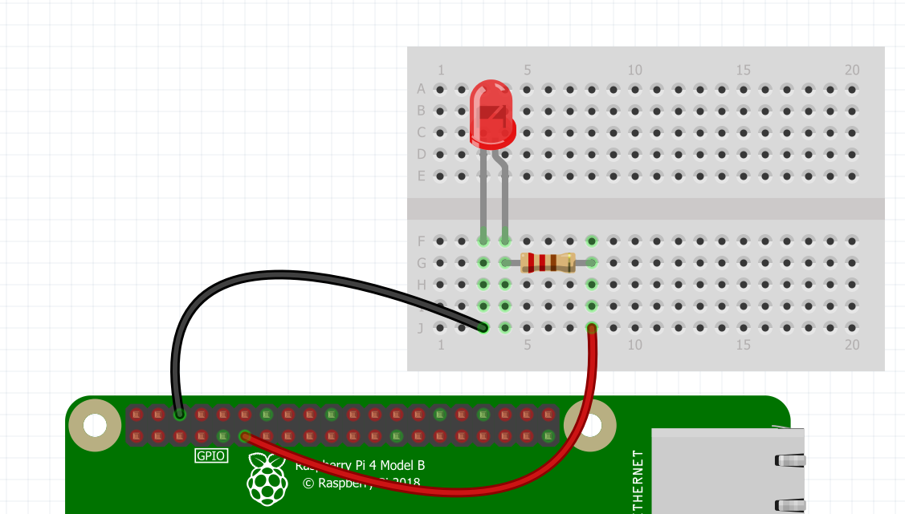
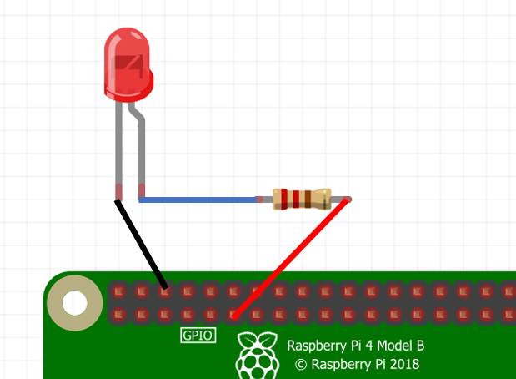
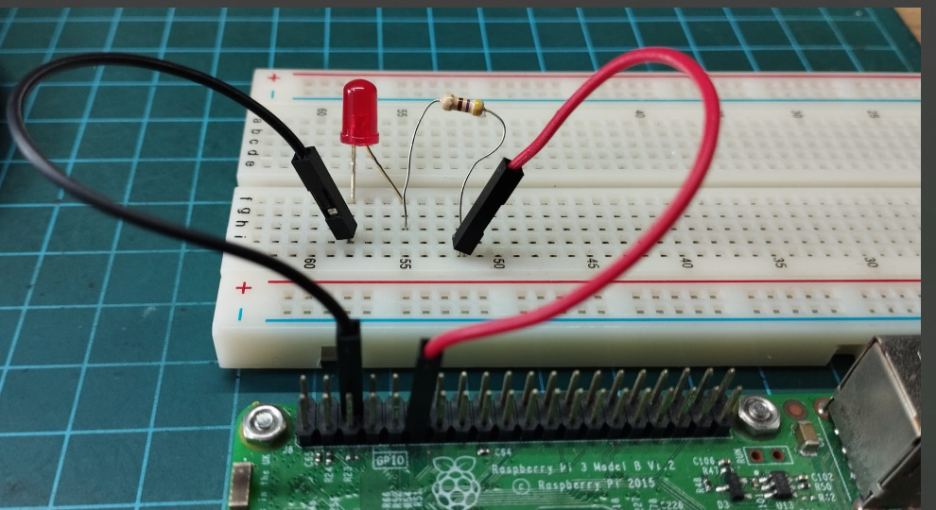

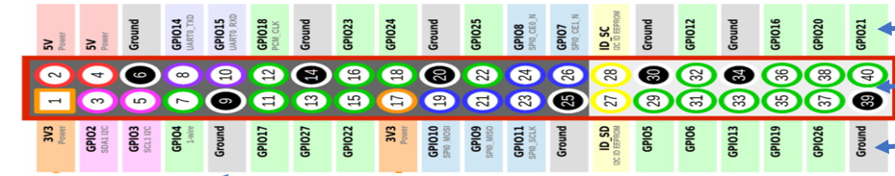
GROUND
GPIO 17

Slide 3
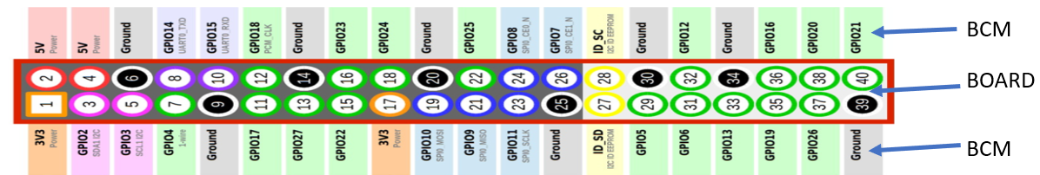
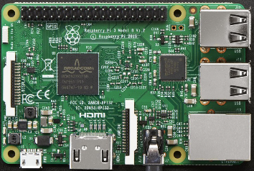

RASPBERRY PI GPIO PIN NUMBERING SYSTEM
We Use the numbers inside the blue rectangles
USB PORTS
ALWAYS ON
YOUR RIGHT
Pin 14
Pin 19

Slide 4
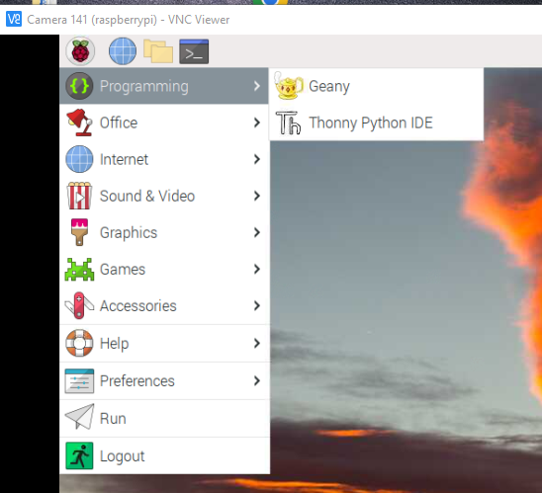
INTRODUCTION TO THE THONNY INTEGRATED DEVELOPMENT ENVIRONMENT [IDE]
Click Start (Raspberry Icon)
Select Programming
Select Thonny Python IDE

Slide 5
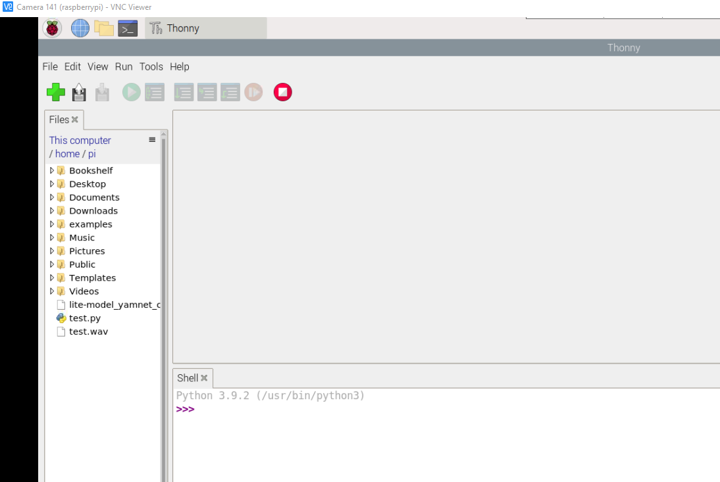
THE THONNY IDE HAS TWO PORTIONS TO RUN OUR PYTHON CODES
Default Directory /home/pi
EDITOR
THE INTEGRATED DEVELOPMENT
ENVIRONMENT – I.D.E
SHELL

Slide 6
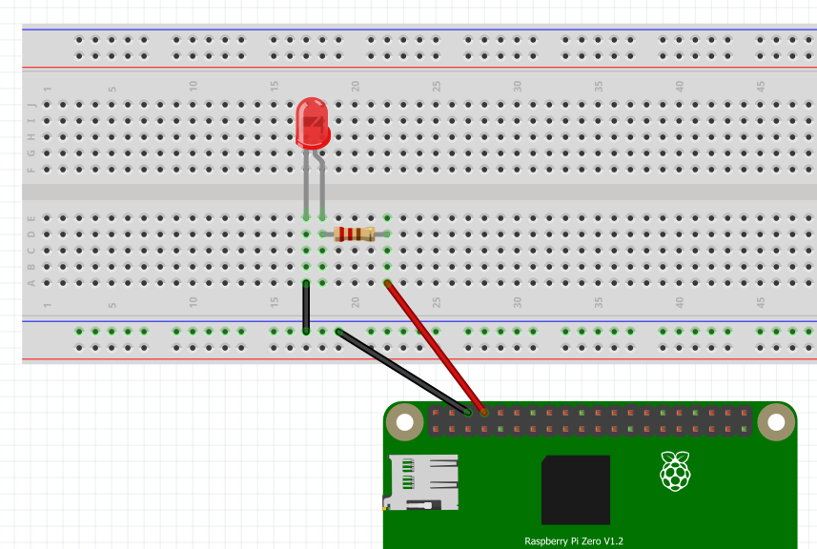
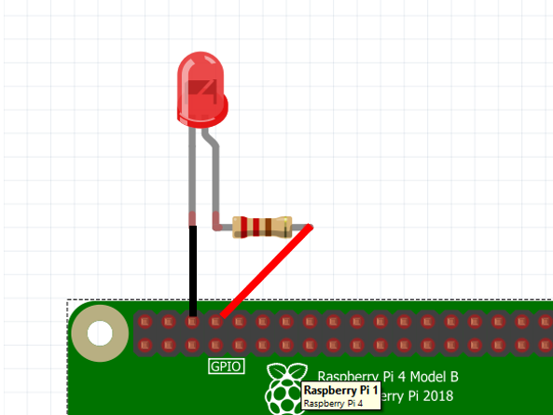
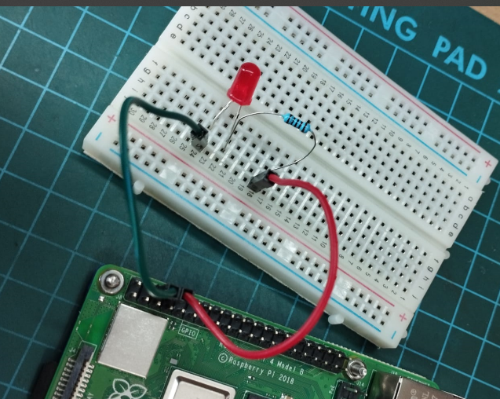

EXERCISE #1
Wiring a Light Emitting Diode (LED)
LED
-VE CATHODE
+ve ANODE
200 OHM RESISTOR
GROUND
(BCM) - PIN 14

Slide 7
TESTING OUR CIRCUIT USING THE PYTHON LANGUAGE
Ex 1a. Turning our Red LED on
>>> from gpiozero import LED
>>> red_led = LED(14)
>>> red_led.on()
Ex 1b. Turning it off
>>> red_led.off()
Ex 1c. Make it blink (1 sec on 1 sec off)
>>> red_led.blink()
Ex 1d. Make it pulsate a number of times
>>> red_led.blink(on_time=.5, off_time=.8, n=5)

Slide 8
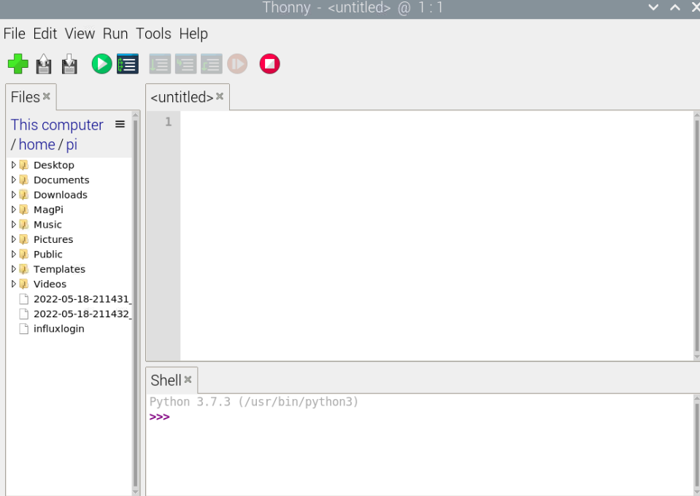

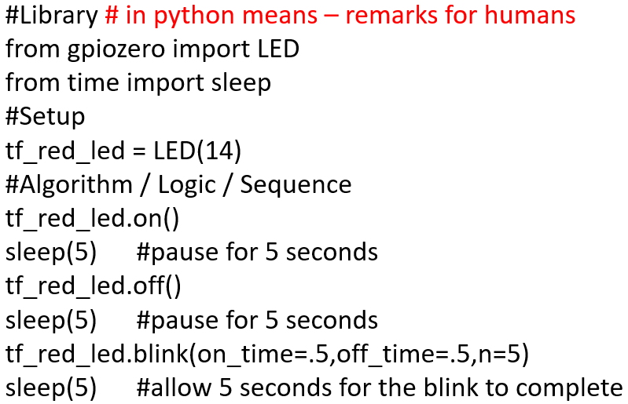

Click the to open a new file
Exercise 1 - WRITING OUR FIRST PYTHON PROGRAM USING THE THONNY IDE
Ex 1e. Creating our 1st Raspberry Pi Python Program
Click on the green + icon to open a new page
And type these codes into the Editor
#Library # in python means – remarks for humans
from gpiozero import LED
from time import sleep
#Setup
tf_red_led = LED(14)
#Algorithm / Logic / Sequence
tf_red_led.on()
sleep(5) #pause for 5 seconds
tf_red_led.off()
sleep(5) #pause for 5 seconds
tf_red_led.blink(on_time=.5,off_time=.5,n=5)
sleep(5) #allow 5 seconds for the blink to complete
Type the program in the space here
Save this program
File -> Save [provide a programme name. E.g. Excercise1.py then click OK
Click Run or the play icon to run the program
The first time you save, you will be required to give the program a name. E.g. Exercise1
Then click the to run the program
Click the icon to save the program

Slide 9
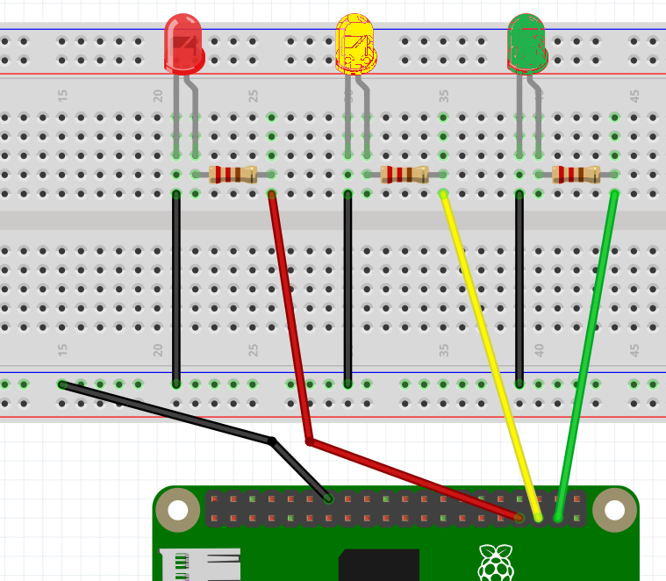


EXERCISE #2
Wiring for a Traffic Light
GROUND
PIN 13
PIN 19
PIN 26

Slide 10
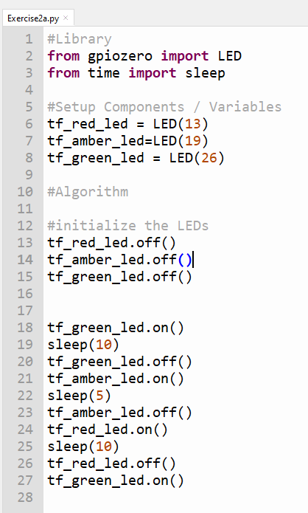
Ex. 2a – Using the Logic from 1e, implement this.
Save program as Exercise2a.py
ALGORITHM FOR A TRAFFIC LIGHT SYSTEM
STARTS WITH GREEN
AFTER 10 SECONDS
GREEN GOES OFF
AMBER COMES ON
AFTER 5 SECONDS
AMBER GOES OFF
RED COMES ON
AFTER 10 SECONDS
GREEN COMES ON

